Slide 1
IOS App Development
Mrs Sharmila Deo

Slide 2
IOS - What is it
iOS is Apple's mobile operating system that powers the iPhone and iPod Touch. Until 2019, it was also the operating system used by the iPad.
An operating system (OS) is a type of software that's key to a computer working because it manages all aspects of a device. It provides a platform so the device's hardware and software can interact, plus manages the many processes that run on your computer.
On your desktop computer, you probably run the Windows, macOS, or Linux operating system. For mobile devices, Apple's iOS and Google's Android are the most popular.

Slide 3
. When the iPhone was introduced in 2007, its operating system was originally called "iPhone OS." Despite the name, the iPod Touch (which launched later in 2007) also ran iPhone OS.
In 2010, Apple introduced the iPad, which ran the same OS. When the fourth version of the mobile OS launched later that year, Apple decided to rebrand the operating system's name as "iOS," since it wasn't just the iPhone that used it anymore.
At the time, Steve Jobs said that "iMac comes from the marriage of the excitement of the internet with the simplicity of Macintosh." Apple expounded on this with a slide showing that the "i" prefix also stands for individual, instruct, inform, and inspire.

Slide 4
Xcode is Apple’s integrated development environment (IDE) that you use to build apps for Apple products including the iPad, iPhone, Apple Watch, and Mac. Xcode provides tools to manage your entire development workflow—from creating your app, to testing, optimizing, and submitting it to the App Store.\

Slide 5
Working with Targets
Every project contains at least one target. A target specifies a product to build, such as an iOS, watchOS, or OS X app. Select a target in the project editor to view and modify the target’s settings.
Applying App-Specific Target Settings
The General pane for a target shows basic settings that you occasionally check and possibly edit. You typically assign values for these settings elsewhere during the app development process, for example, in dialogs that appear when you create a new project.
For an iOS app, the General pane contains target settings for:

Slide 6
The bundle identifier, a string that identifies the app to the operating system and to the App Store
The version number under which to publish the app
The build number, which identifies a particular build of the app
The name of your Apple Developer Program development team
The deployment target, which is the earliest iOS version on which the app runs
The devices for which to build the app
The main user interface file to load when the app launches
The user interface orientations (portrait, upside down, landscape left, landscape right) that the app supports

Slide 7
Adding Technology Features to a Target
To add various Apple technologies—such as iCloud, Game Center, In-App Purchase, and Maps—to your app, select its target in the project editor and click Capabilities. Add a capability by setting a switch to On. Xcode adds the necessary entitlements file to your project and links the target to the necessary frameworks. In some cases, Xcode might encounter issues enabling a capability. If so, that information will be displayed in the information area for that capability.
You can show or hide detail for a capability by clicking the disclosure triangle to the left of the capability name. For capabilities that are off, this area describes the capability and actions that occur when the capability is turned on. For capabilities that are on, use this area to view or update any associated configuration and to identify issues that need fixing.

Slide 8
Adding On-Demand Resource Tags to a Target
On-demand resources are app contents that you download only when needed. They are hosted on the App Store separately from the app bundle downloaded by the user. You can use on-demand resources to enable smaller apps, faster downloads, and richer app content. You use tags to identify and manage the on-demand resources in a target.
The Resource Tags pane shows the list of tags and the associated resources. You can use it to add and remove tags as well as to move resources between tags.

Slide 9
Adding File Type and Service Information to a Target
The Info pane for a target shows properties associated with your app, file types that your app can create or open, and for OS X, services provided by your app. Most of the custom target properties are modified in other parts of the Xcode interface (such as the bundle identifier, version, and build number set in the General pane). The screenshot shows the Info pane for the iOS target of the Adventure app.

Slide 10
Overriding Build Settings for a Target
A target contains instructions—in the form of build settings and build phases—for building a product. A target inherits the project’s build settings. Although most developers seldom need to change these settings, you can override any of the project’s build settings by specifying different settings at the target level. Select a target in the project editor to modify the target settings in the Info, Build Settings, or Build Phases pane.

Slide 11
Working with Projects
Apps you create in Xcode require a project, which keeps the necessary files and resources organized. You start a project by choosing File > New > New Project. Xcode opens a new workspace window and displays a dialog in which you choose a project template. Xcode provides built-in templates for developing common styles of iOS, watchOS, and OS X apps. These templates include essential project configuration and files that help you start your development effort quickly.

Slide 12
A Project Is a Repository of Files and Resources for Building Apps
A project contains the elements needed to build one or more apps (or other software products, such as command-line tools and plug-ins). The project also maintains the relationships among these elements. These elements include:
References to source code files (including implementation files and header files where appropriate), libraries and frameworks, image files, and user interface files Groups, for organizing files in the project navigator Project-level build configurations Targets, each of which produces a single app

Slide 13
When you create a project, Xcode provides two standard project-level build configurations: debug and release. These configurations differ mostly in whether they include debug information and in the degree to which each build is optimized. These two build configurations are probably sufficient for your product development needs. Most developers never need to change the values of the vast majority of build settings.
To add more build configurations, open the project editor, duplicate one of the project’s existing configurations, and then modify its settings. For example, you might configure a build that’s fully optimized but that also includes debug information in order to debug your optimized code.

Slide 14
Closing and Opening a Project or a Workspace
To close a project or workspace, choose File > Close Project or File > Close Workspace. Xcode remembers which windows you had open and how they were configured, and it restores them when you reopen the project or workspace.

Slide 15
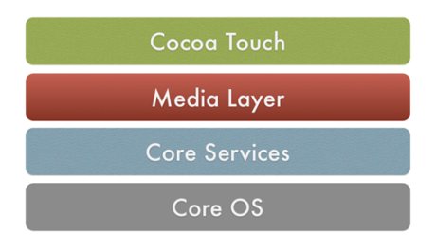
OS Application Architecture
https://medium.com/@lucideus/understanding-the-structure-of-an-ios-application-a3144f1140d4
The iOS components that support iOS applications together with the application layer make up the architecture of an iOS application.

Slide 16
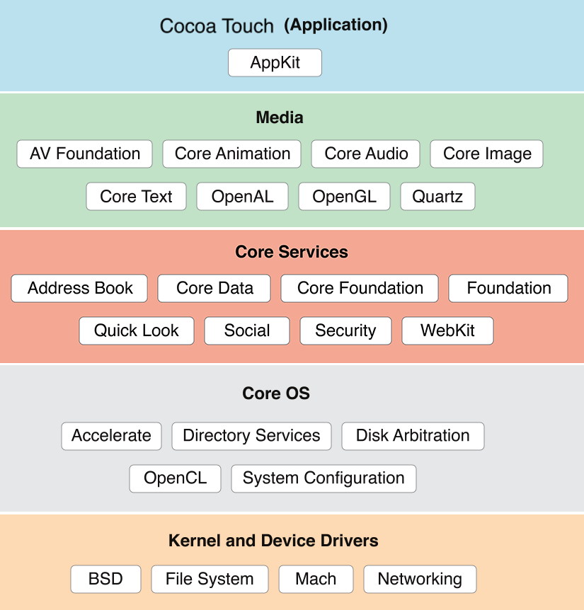

Slide 17
Cocoa has a very important role to play for supporting an iOS application. It provides UIKit for the application to work which is essentially the USP of an iOS application
We would be currently focusing on native iOS applications. A native iOS application can use Objective C or Swift code along with any of their native libraries or frameworks available of use in iOS applications. We have learnt how to extract the IPA file of an iOS application from a jailbroken device. Let us analyse what an IPA file consists of.

Slide 18
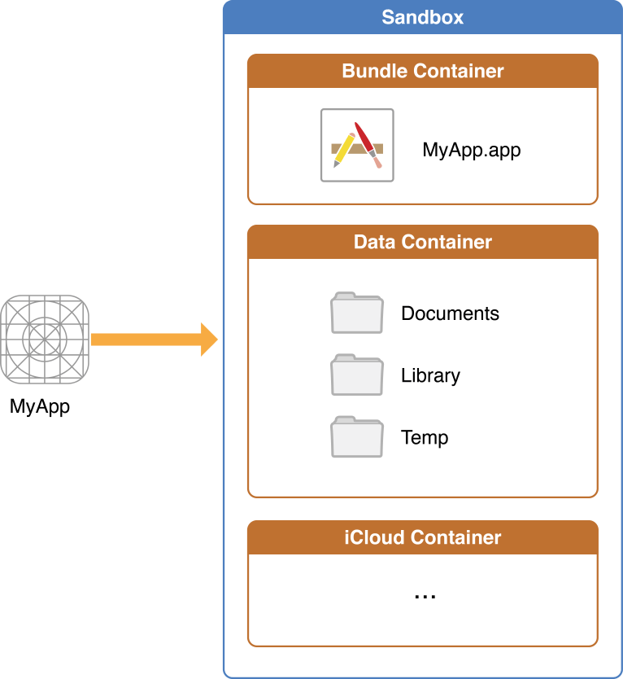

Slide 19
The Bundle Container
The Bundle directory or the IPA container consists of all the files that come along with the application when installed from the Apple’s App Store or any other source. So, the files in this directory will remain same throughout in a particular version of an application.
The structure of this directory for ‘Facebook’ application is depicted in the following screenshot.

Slide 20
The Data Container
The “Data” directory or the Local Data Storage container consists of the files that the developer wishes to store for the application during the time which the application is installed on the device.
The files may be used for caching information for quick access or storing offline information as a backup for resuming the application from the point at intended by the developer. So, the files in this directory and also the information in the files will keep on changing while the application is in use as coded by the developers

Slide 21
Very critical information about the user or the application might be obtained from these files depending on what information is intended to be stored by the developer in this directory. Some of the possible components of the “Data” directory of an iOS application are explained below:

Slide 22
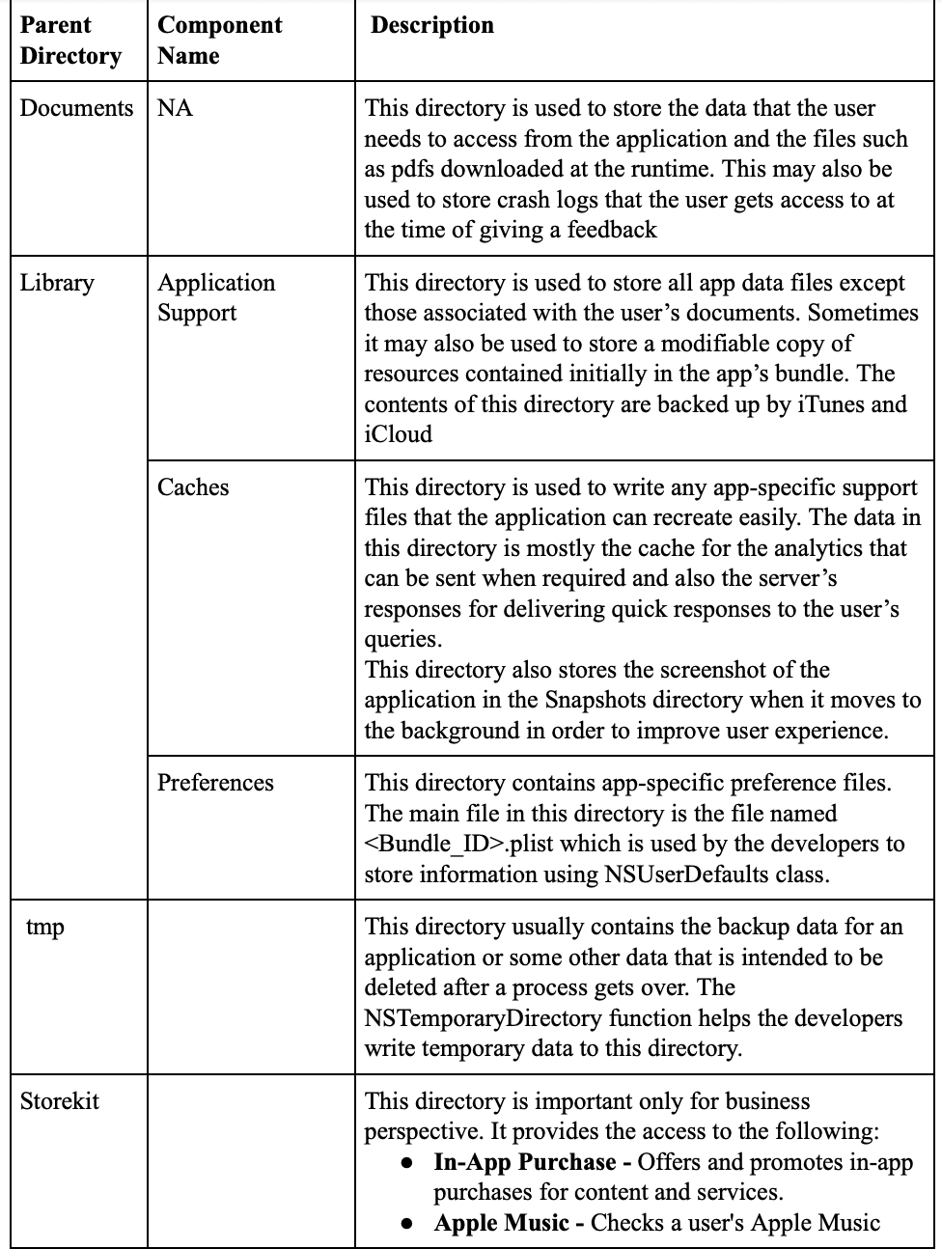

Slide 23
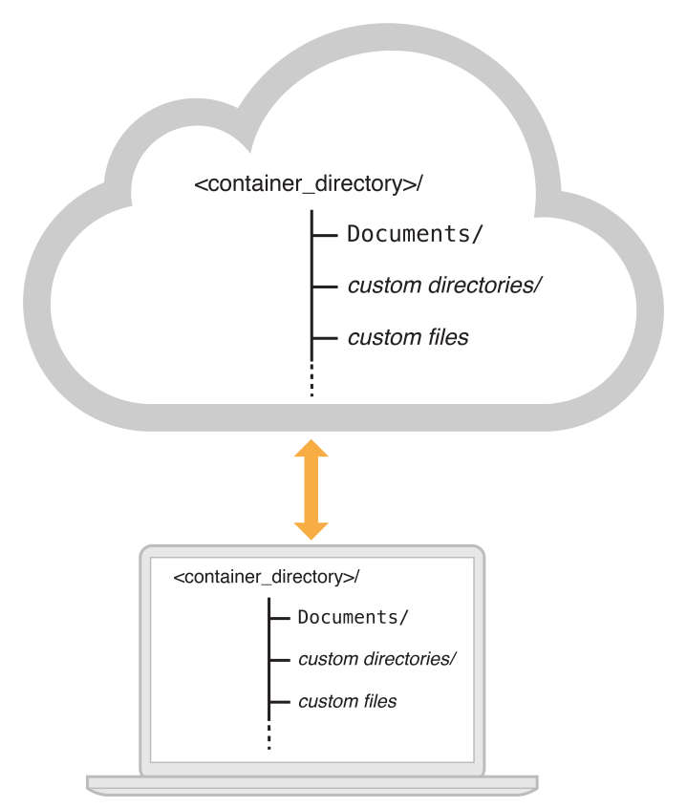
The iCloud Container

Slide 24
This directory contains data that iCloud enabled iOS applications use. The files in this directory are meant to stored and updated by the sources where a user decides to update the file from.
It consists of usually two parts
Documents- The files in this directory are meant to be read and updated directly by the user. These files are backed up to iCloud regularly to keep in sync.
Data- These files are not meant to be edited or added directly by the user. Data may be kept in different directories as desired by the developer.

Slide 25
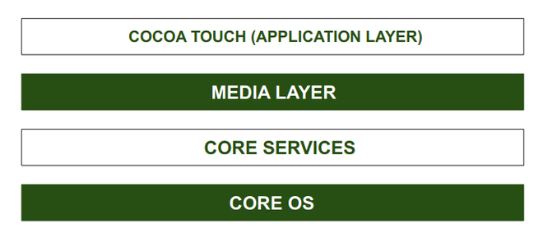
Frameworks-
https://www.geeksforgeeks.org/architecture-of-ios-operating-system/

Slide 26
A framework is a directory that holds dynamic shared libraries like .a files, header files, images, and helper apps that support the library. Each layer has a set of frameworks that are helpful for developers.
CORE OS Layer:
All the IOS technologies are built under the lowest level layer i.e. Core OS layer. These technologies include:
Core Bluetooth Framework
External Accessories Framework
Accelerate Framework
Security Services Framework
Local Authorization Framework etc.
It supports 64 bit which enables the application to run faster.

Slide 27
CORE SERVICES Layer:
Some important frameworks are present in the CORE SERVICES Layer which helps the iOS operating system to cure itself ad provide better functionality. It is the 2nd lowest layer in the Architecture as shown above. Below are some important frameworks present in this layer:
Address Book Framework- The Address Book Framework provides access to the contact details of the user.
Cloud Kit Framework- This framework provides a medium for moving data between your app and iCloud.
Core Data Framework- This is the technology that is used for managing the data model of a Model View Controller app.
Core Foundation Framework- This framework provides data management and service features for iOS applications.
Core Location Framework- This framework helps to provide the location and heading information to the application.
Core Motion Framework- All the motion-based data on the device is accessed with the help of the Core Motion Framework.

Slide 28
Foundation Framework- Objective C covering too many of the features found in the Core Foundation framework.
HealthKit Framework- This framework handles the health-related information of the user.
HomeKit Framework- This framework is used for talking with and controlling connected devices with the user’s home.
Social Framework- It is simply an interface that will access users’ social media accounts.
StoreKit Framework- This framework supports for buying of contents and services from inside iOS apps.

Slide 29
MEDIA Layer:
With the help of the media layer, we will enable all graphics video, and audio technology of the system. This is the second layer in the architecture. The different frameworks of MEDIA layers are:
ULKit Graphics- This framework provides support for designing images and animating the view content.
Core Graphics Framework- This framework support 2D vector and image-based rendering ad it is a native drawing engine for iOS.
Core Animation- This framework helps in optimizing the animation experience of the apps in iOS.

Slide 30
Media Player Framework- This framework provides support for playing the playlist and enables the user to use their iTunes library.
AV Kit- This framework provides various easy-to-use interfaces for video presentation, recording, and playback of audio and video.
Open AL- This framework is an Industry Standard Technology for providing Audio.
Core Images- This framework provides advanced support for motionless images.
GL Kit- This framework manages advanced 2D and 3D rendering by hardware-accelerated interfaces.

Slide 31
COCOA TOUCH:
COCOA Touch is also known as the application layer which acts as an interface for the user to work with the iOS Operating system. It supports touch and motion events and many more features. The COCOA TOUCH layer provides the following frameworks :
EvenKit Framework- This framework shows a standard system interface using view controllers for viewing and changing events.
GameKit Framework- This framework provides support for users to share their game-related data online using a Game Center.

Slide 32
MapKit Framework- This framework gives a scrollable map that one can include in your user interface of the app.
PushKit Framework- This framework provides registration support.

Slide 33
Threads and communication
https://developer.apple.com/library/archive/documentation/Cocoa/Conceptual/Multithreading/AboutThreads/AboutThreads.html#//apple_ref/doc/uid/10000057i-CH6-SW3
What Are Threads?
Threads are a relatively lightweight way to implement multiple paths of execution inside of an application. At the system level, programs run side by side, with the system doling out execution time to each program based on its needs and the needs of other programs. Inside each program, however, exists one or more threads of execution, which can be used to perform different tasks simultaneously or in a nearly simultaneous manner. The system itself actually manages these threads of execution, scheduling them to run on the available cores and preemptively interrupting them as needed to allow other threads to run.
From a technical standpoint, a thread is a combination of the kernel-level and application-level data structures needed to manage the execution of code. The kernel-level structures coordinate the dispatching of events to the thread and the preemptive scheduling of the thread on one of the available cores. The application-level structures include the call stack for storing function calls and the structures the application needs to manage and manipulate the thread’s attributes and state.

Slide 34
In a non-concurrent application, there is only one thread of execution. That thread starts and ends with your application’s main routine and branches one-by-one to different methods or functions to implement the application’s overall behavior. By contrast, an application that supports concurrency starts with one thread and adds more as needed to create additional execution paths. Each new path has its own custom start routine that runs independently of the code in the application’s main routine. Having multiple threads in an application provides two very important potential advantages:
Multiple threads can improve an application’s perceived responsiveness.
Multiple threads can improve an application’s real-time performance on multicore systems.
If your application has only one thread, that one thread must do everything. It must respond to events, update your application’s windows, and perform all of the computations needed to implement your application’s behavior. The problem with having just one thread is that it can only do one thing at a time. So what happens when one of your computations takes a long time to finish? While your code is busy computing the values it needs, your application stops responding to user events and updating its windows. If this behavior continues long enough, a user might think your application is hung and try to forcibly quit it. If you moved your custom computations onto a separate thread, however, your application’s main thread would be free to respond to user interactions in a more timely manner.

Slide 35
Threading Terminology
Before getting too far into discussions about threads and their supporting technologies, it is necessary to define some basic terminology.
If you are familiar with UNIX systems, you may find that the term “task” is used differently by this document. On UNIX systems, the term “task” is used at times to refer to a running process.
This document adopts the following terminology:
The term thread is used to refer to a separate path of execution for code.
The term process is used to refer to a running executable, which can encompass multiple threads.
The term task is used to refer to the abstract concept of work that needs to be performed.

Slide 36
Alternatives to Threads
One problem with creating threads yourself is that they add uncertainty to your code. Threads are a relatively low-level and complicated way to support concurrency in your application. If you do not fully understand the implications of your design choices, you could easily encounter synchronization or timing issues, the severity of which can range from subtle behavioral changes to the crashing of your application and the corruption of the user’s data.
Another factor to consider is whether you need threads or concurrency at all. Threads solve the specific problem of how to execute multiple code paths concurrently inside the same process. There may be cases, though, where the amount of work you are doing does not warrant concurrency. Threads introduce a tremendous amount of overhead to your process, both in terms of memory consumption and CPU time. You may discover that this overhead is too great for the intended task, or that other options are easier to implement.

Slide 37
Inter-thread Communication
Although a good design minimizes the amount of required communication, at some point, communication between threads becomes necessary. (A thread’s job is to do work for your application, but if the results of that job are never used, what good is it?) Threads may need to process new job requests or report their progress to your application’s main thread. In these situations, you need a way to get information from one thread to another. Fortunately, the fact that threads share the same process space means you have lots of options for communication.
There are many ways to communicate between threads, each with its own advantages and disadvantages. Configuring Thread-Local Storage lists the most common communication mechanisms you can use in OS X. (With the exception of message queues and Cocoa distributed objects, these technologies are also available in iOS.) The techniques in this table are listed in order of increasing complexity.

Slide 38
Mechanism
Description
Direct messaging
Cocoa applications support the ability to perform selectors directly on other threads. This capability means that one thread can essentially execute a method on any other thread. Because they are executed in the context of the target thread, messages sent this way are automatically serialized on that thread. For information about input sources, see Cocoa Perform Selector Sources.
Global variables, shared memory, and objects
Another simple way to communicate information between two threads is to use a global variable, shared object, or shared block of memory. Although shared variables are fast and simple, they are also more fragile than direct messaging. Shared variables must be carefully protected with locks or other synchronization mechanisms to ensure the correctness of your code. Failure to do so could lead to race conditions, corrupted data, or crashes.
Conditions
Conditions are a synchronization tool that you can use to control when a thread executes a particular portion of code. You can think of conditions as gate keepers, letting a thread run only when the stated condition is met. For information on how to use conditions, see Using Conditions.
Run loop sources
A custom run loop source is one that you set up to receive application-specific messages on a thread. Because they are event driven, run loop sources put your thread to sleep automatically when there is nothing to do, which improves your thread’s efficiency. For information about run loops and run loop sources, see Run Loops.

Slide 39
Ports and sockets
Port-based communication is a more elaborate way to communication between two threads, but it is also a very reliable technique. More importantly, ports and sockets can be used to communicate with external entities, such as other processes and services. For efficiency, ports are implemented using run loop sources, so your thread sleeps when there is no data waiting on the port. For information about run loops and about port-based input sources, see Run Loops.
Message queues
The legacy Multiprocessing Services defines a first-in, first-out (FIFO) queue abstraction for managing incoming and outgoing data. Although message queues are simple and convenient, they are not as efficient as some other communications techniques. For more information about how to use message queues, see Multiprocessing Services Programming Guide.
Cocoa distributed objects
Distributed objects is a Cocoa technology that provides a high-level implementation of port-based communications. Although it is possible to use this technology for inter-thread communication, doing so is highly discouraged because of the amount of overhead it incurs. Distributed objects is much more suitable for communicating with other processes, where the overhead of going between processes is already high. For more information, see Distributed Objects Programming Topics.

Slide 40
If your application has only one thread, that one thread must do everything. It must respond to events, update your application’s windows, and perform all of the computations needed to implement your application’s behavior. The problem with having just one thread is that it can only do one thing at a time. So what happens when one of your computations takes a long time to finish? While your code is busy computing the values it needs, your application stops responding to user events and updating its windows. If this behavior continues long enough, a user might think your application is hung and try to forcibly quit it. If you moved your custom computations onto a separate thread, however, your application’s main thread would be free to respond to user interactions in a more timely manner.
With multicore computers common these days, threads provide a way to increase performance in some types of applications. Threads that perform different tasks can do so simultaneously on different processor cores, making it possible for an application to increase the amount of work it does in a given amount of time
f course, threads are not a panacea for fixing an application’s performance problems. Along with the benefits offered by threads come the potential problems. Having multiple paths of execution in an application can add a considerable amount of complexity to your code. Each thread has to coordinate its actions with other threads to prevent it from corrupting the application’s state information. Because threads in a single application share the same memory space, they have access to all of the same data structures. If two threads try to manipulate the same data structure at the same time, one thread might overwrite another’s changes in a way that corrupts the resulting data structure. Even with proper protections in place, you still have to watch out for compiler optimizations that introduce subtle (and not so subtle) bugs into your code.

Slide 41
Swift is a fantastic way to write software, whether it’s for phones, desktops, servers, or anything else that runs code. It’s a safe, fast, and interactive programming language that combines the best in modern language thinking with wisdom from the wider Apple engineering culture and the diverse contributions from its open-source community. The compiler is optimized for performance and the language is optimized for development, without compromising on either.

Slide 42
Swift is friendly to new programmers. It’s an industrial-quality programming language that’s as expressive and enjoyable as a scripting language.
Swift defines away large classes of common programming errors by adopting modern programming patterns:
Variables are always initialized before use.
Array indices are checked for out-of-bounds errors.
Integers are checked for overflow.
Optionals ensure that nil values are handled explicitly.
Memory is managed automatically.
Error handling allows controlled recovery from unexpected failures.

Slide 43
Simple Values
Use let to make a constant and var to make a variable. The value of a constant doesn’t need to be known at compile time, but you must assign it a value exactly once. This means you can use constants to name a value that you determine once but use in many places.
var myVariable = 42
myVariable = 50
let myConstant = 42

Slide 44
If the initial value doesn’t provide enough information (or if isn’t an initial value), specify the type by writing it after the variable, separated by a colon.
let implicitInteger = 70
let implicitDouble = 70.0
let explicitDouble: Double = 70

Slide 45
Values are never implicitly converted to another type. If you need to convert a value to a different type, explicitly make an instance of the desired type.
let label = "The width is "
let width = 94
let widthLabel = label + String(width)

Slide 46
There’s an even simpler way to include values in strings: Write the value in parentheses, and write a backslash (\) before the parentheses. For example:
let apples = 3
let oranges = 5
let appleSummary = "I have \(apples) apples."
let fruitSummary = "I have \(apples +

Slide 47
Create arrays and dictionaries using brackets ([]), and access their elements by writing the index or key in brackets. A comma is allowed after the last element.
var shoppingList = ["catfish", "water", "tulips"]
shoppingList[1] = "bottle of water"
var occupations = [
"Malcolm": "Captain",
"Kaylee": "Mechanic",
]
occupations["Jayne"] = "Public Relations"

Slide 48
To create an empty array or dictionary, use the initializer syntax.
let emptyArray: [String] = []
let emptyDictionary: [String: Float] = [:]
If type information can be inferred, you can write an empty array as [] and an empty dictionary as [:]—for example, when you set a new value for a variable or pass an argument to a function.
shoppingList = []
occupations = [:]

Slide 49
Swift 4 also introduces Optionals type, which handles the absence of a value. Optionals say either "there is a value, and it equals x" or "there isn't a value at all".
An Optional is a type on its own, actually one of Swift 4’s new super-powered enums. IHere’s an optional Integer declaration −
var perhapsInt: Int?
Here’s an optional String declaration −
var perhapsStr: String?

Slide 50
The above declaration is equivalent to explicitly initializing it to nil which means no value −
var perhapsStr: String? = nil
Let's take the following example to understand how optionals work in Swift 4 −
var myString:String? = nil
if myString != nil {
print(myString)
} else {
print("myString has nil value")
}
When we run the above program using playground, we get the following result −
myString has nil value

Slide 51
Forced Unwrapping
If you defined a variable as optional, then to get the value from this variable, you will have to unwrap it. This just means putting an exclamation mark at the end of the variable.
Let's take a simple example −
var myString:String?
myString = "Hello, Swift 4!"
if myString != nil {
print(myString)
} else {
print("myString has nil value")
}

Slide 52
When we run the above program using playground, we get the following result −
Optional("Hello, Swift 4!")
Now let's apply unwrapping to get the correct value of the variable −
var myString:String?
myString = "Hello, Swift 4!"
if myString != nil {
print( myString! )
} else {
print("myString has nil value")

Slide 53
When we run the above program using playground, we get the following result −
Optional("Hello, Swift !")
Now let's apply unwrapping to get the correct value of the variable −
var myString:String?
myString = "Hello, Swift !"
if myString != nil {
print( myString! )
} else {
print("myString has nil value")
}

Slide 54
Automatic Unwrapping
You can declare optional variables using exclamation mark instead of a question mark. Such optional variables will unwrap automatically and you do not need to use any further exclamation mark at the end of the variable to get the assigned value. Let's take a simple example −
var myString:String!
myString = "Hello, Swift 4!"
if myString != nil {
print(myString)
} else {
print("myString has nil value")
}

Slide 55
When we run the above program using playground, we get the following result −
Hello, Swift !

Slide 56
Optional Binding
Use optional binding to find out whether an optional contains a value, and if so, to make that value available as a temporary constant or variable.
An optional binding for the if statement is as follows −
if let constantName = someOptional {
statements
}
Let's take a simple example to understand the usage of optional binding −
var myString:String?
myString = "Hello, Swift 4!"

Slide 57
if let yourString = myString {
print("Your string has - \(yourString)")
} else {
print("Your string does not have a value")
}
When we run the above program using playground, we get the following result −
Your string has - Hello, Swift !

Slide 58
The process of querying, calling properties, subscripts and methods on an optional that may be 'nil' is defined as optional chaining. Optional chaining return two values −
if the optional contains a 'value' then calling its related property, methods and subscripts returns values
if the optional contains a 'nil' value all its its related property, methods and subscripts returns nil
Since multiple queries to methods, properties and subscripts are grouped together failure to one chain will affect the entire chain and results in 'nil' value

Slide 59
Optional Chaining as an Alternative to Forced Unwrapping
Optional chaining is specified after the optional value with '?' to call a property, method or subscript when the optional value returns some values.
Optional Chaining '?'
Access to methods,properties and subscriptsOptional Chaining '!' to force Unwrapping
? is placed after the optional value to call property, method or subscript
! is placed after the optional value to call property, method or subscript to force unwrapping of value
Fails gracefully when the optional is 'nil'
Forced unwrapping triggers a run time error when the optional is 'nil'

Slide 60
class Student {
var degree: Course?
}
class Course {
var courseTitle = "B.Tech"
}

Slide 61
Now, if you create a new Student instance ,its degree property is by default initialized to nil because it is optional . So in the code below, nidhi has a degree property value of nil.
let nidhi = Student()
let courseName = nidhi.degree!.courseTitle
// this triggers a runtime error

Slide 62
Now let’s see how optional chaining works differently with following example.
if let courseName = nidhi.degree?.courseTitle {
print("Nidhi is pursuing \(courseName).")
}
else {
print("Unable to retrieve course name.")
}
// Prints "Unable to retrieve course name.

Slide 63
if it is nil then the chain is broken and else part of code is executed. Note that though courseTitle is a non-optional String, as it is queried through an optional chain means that the call to courseTitle will always return a String? instead of a String. So now let’s assign Course instance to nidhi.degree so that it no longer contains nil value.
nidhi.degree = courseTitle()
Now if you try to access the courseTitle with above optional chaining, it will now return string? which contains default courseTitle value of “B.Tech” . So output will be “Nidhi is persuing B.Tech.”

Slide 64
/*What is comman in structures and classes
Define properties to store values
Define methods to provide functionality
Define subscripts to provide access to their values using subscript syntax
Define initializers to set up their initial state
Be extended to expand their functionality beyond a default implementation
Conform to protocols to provide standard functionality of a certain kind

Slide 65
Classes support a few more capabilities that structs don’t have:
Classes can inherit from another class, like you inherit from UIViewController to create your own view controller subclass
Classes can be deinitialized, i.e. you can call a function before the class is destroyed
Classes are reference types and structs are value types
Value Type: When you copy a value type (i.e., when it’s assigned, initialized or passed into a function), each instance keeps a unique copy of the data. If you change one instance, the other doesn’t change too.
Reference Type: When you copy a referenve type, each instance shares the data. The reference itself is copied, but not the data it references. When you change one, the other changes too.

Slide 66
When Should You Use Structs?
Use structs for simple data types. Think about database objects you want to pass around in your code, like NewsItem, Task or User. Since they’re so well-defined, and often don’t need to accommodate complex relationships between objects, it’s simpler to use structs.
In a multi-threaded environment, for instance with a database connection that’s opened in a different thread, structs are safer. They can be copied from one thread to another thread, without running the risk of a race condition or deadlock. Classes do not have this inherent safety, unless they’re deliberately made thread-safe.
When the properties of a struct are mostly value types too, like String, it makes sense to wrap them in a struct instead of a class. It’s OK to use structs within class types, but pay extra attention if you use classes within struct types. Classes are reference types, so if you’re unaware that your struct references a shared class instance – you’re in for trouble!
when Should You use classes

Slide 67
Classes can inherit from another class, which you can’t do with structs. With classes, you can write class MyViewController : UIViewController to create a subclass of UIViewController. Conversely, structs can implement protocols.
Classes can be deinitialized, i.e. they can implement a deinit function, and you can make one or more references to the same class (i.e., classes are a reference type).
Classes come with the built-in notion of identity, because they’re reference types. With the identity operator === you can check if two references (variables, constants, properties, etc.) refer to the same object.

Slide 68
struct Resolution {
var width = 0
var height = 0
}

Slide 69
class VideoMode {
var resolution = Resolution()
var interlaced = false
var frameRate = 0.0
var name: String?
}
}

Slide 70
let someResolution = Resolution()
let someVideoMode = VideoMode()

Slide 71
Function Definition
In Swift 4, a function is defined by the "func" keyword. When a function is newly defined, it may take one or several values as input 'parameters' to the function and it will process the functions in the main body and pass back the values to the functions as output 'return types'.
Every function has a function name, which describes the task that the function performs. To use a function, you "call" that function with its name and pass input values (known as arguments) that match the types of the function's parameters. Function parameters are also called as 'tuples'.
A function's arguments must always be provided in the same order as the function's parameter list and the return values are followed by →.

Slide 72
Syntax
func funcname(Parameters) -> returntype {
Statement1
Statement2
---
Statement N
return parameters
}
Take a look at the following code. The student’s name is declared as string datatype declared inside the

Slide 73
func student(name: String) -> String {
return name
}
print(student(name: "First Program"))
print(student(name: "About Functions"))
When we run the above program using playground, we get the following result −
First Program
About Functions

Slide 74
Calling a Function
Let us suppose we defined a function called 'display' to Consider for example to display the numbers a function with function name 'display' is initialized first with argument 'no1' which holds integer data type. Then the argument 'no1' is assigned to argument 'a' which hereafter will point to the same data type integer. Now the argument 'a' is returned to the function. Here display() function will hold the integer value and return the integer values when each and every time the function is invoked.

Slide 75
func display(no1: Int) -> Int {
let a = no1
return a
}
print(display(no1: 100))
print(display(no1: 200))
When we run above program using playground, we get the following result −
100
200

Slide 76
Parameters and Return Values
Swift 4 provides flexible function parameters and its return values from simple to complex values. Similar to that of C and Objective C, functions in Swift 4 may also take several forms.
Functions with Parameters
A function is accessed by passing its parameter values to the body of the function. We can pass single to multiple parameter values as tuples inside the function.
func mult(no1: Int, no2: Int) -> Int {
return no1*no2
}
print(mult(no1: 2, no2: 20))
print(mult(no1: 3, no2: 15))
print(mult(no1: 4, no2: 30))

Slide 77
When we run above program using playground, we get the following result −
40
45
120
Functions without Parameters
We may also have functions without any parameters.
Syntax

Slide 78
unc funcname() -> datatype {
return datatype
}
Following is an example having a function without a parameter −
Live Demo
func votersname() -> String {
return "Alice"
}
print(votersname())
When we run the above program using playground, we get the following result −
Alice

Slide 79
Functions with Return Values
Functions are also used to return string, integer, and float data type values as return types. To find out the largest and smallest number in a given array function 'ls' is declared with large and small integer datatypes.
An array is initialized to hold integer values. Then the array is processed and each and every value in the array is read and compared for its previous value. When the value is lesser than the previous one it is stored in 'small' argument, otherwise it is stored in 'large' argument and the values are returned by calling the function.
Live Demo

Slide 80
func ls(array: [Int]) -> (large: Int, small: Int) {
var lar = array[0]
var sma = array[0]
for i in array[1..<array.count] {
if i < sma {
sma = i
} else if i > lar {
lar = i
}
}
return (lar, sma)

Slide 81
Functions without Return Values
Some functions may have arguments declared inside the function without any return values. The following program declares a and bas arguments to the sum() function. inside the function itself the values for arguments a and b are passed by invoking the function call sum() and its values are printed thereby eliminating return values.
Live Demo
func sum(a: Int, b: Int) {
let a = a + b
let b = a - b
print(a, b)
}

Slide 82
sum(a: 20, b: 10)
sum(a: 40, b: 10)
sum(a: 24, b: 6)
When we run the above program using playground, we get the following result −
30 20
50 40
30 24

Slide 83
Functions with Optional Return Types
Swift 4 introduces 'optional' feature to get rid of problems by introducing a safety measure. Consider for example we are declaring function values return type as integer but what will happen when the function returns a string value or either a nil value. In that case compiler will return an error value. 'optional' are introduced to get rid of these problems.
Optional functions will take two forms 'value' and a 'nil'. We will mention 'Optionals' with the key reserved character '?' to check whether the tuple is returning a value or a nil value.

Slide 84
func minMax(array: [Int]) -> (min: Int, max: Int)? {
if array.isEmpty { return nil }
var currentMin = array[0]
var currentMax = array[0]
for value in array[1..<array.count] {
if value < currentMin {
currentMin = value
} else if value > currentMax {
currentMax = value
}
}
return (currentMin, currentMax)
}
if let bounds = minMax(array: [8, -6, 2, 109, 3, 71]) {
print("min is \(bounds.min) and max is \(bounds.max)")
}

Slide 85
When we run above program using playground, we get following result −
min is -6 and max is 109
''Optionals' are used to check 'nil' or garbage values thereby consuming lot of time in debugging and make the code efficient and readable for the user.
Functions Local Vs External Parameter Names
Local Parameter Names
Local parameter names are accessed inside the function alone.
func sample(number: Int) {
print(number)
}

Slide 86
When we run above program using playground, we get following result −
min is -6 and max is 109
''Optionals' are used to check 'nil' or garbage values thereby consuming lot of time in debugging and make the code efficient and readable for the user.
Functions Local Vs External Parameter Names
Local Parameter Names
Local parameter names are accessed inside the function alone.
func sample(number: Int) {
print(number)
}

Slide 87
Functions Local Vs External Parameter Names
Local Parameter Names
Local parameter names are accessed inside the function alone.
func sample(number: Int) {
print(number)
}
Here, the func sample argument number is declared as internal variable since it is accessed internally by the function sample(). Here the 'number' is declared as local variable but the reference to the variable is made outside the function with the following statement −

Slide 88
unc sample(number: Int) {
print(number)
}
sample(number: 1)
sample(number: 2)
sample(number: 3)
When we run the above program using playground, we get the following result −
1
2
3

Slide 89
External Parameter Names
External parameter names allow us to name a function parameters to make their purpose more clear. For example below you can name two function parameters and then call that function as follows −
func pow(firstArg a: Int, secondArg b: Int) -> Int {
var res = a
for _ in 1..<b {
res = res * a
}
print(res)
return res
}

Slide 90
pow(firstArg:5, secondArg:3)
When we run the above program using playground, we get the following result −
125

Slide 91
Variadic Parameters
When we want to define function with multiple number of arguments, then we can declare the members as 'variadic' parameters. Parameters can be specified as variadic by (···) after the parameter name.
Live Demo
func vari<N>(members: N...){
for i in members {
print(i)
}

Slide 92
vari(members: 4,3,5)
vari(members: 4.5, 3.1, 5.6)
vari(members: "Swift 4", "Enumerations", "Closures")
When we run the above program using playground, we get the following result −

Slide 93
4
3
5
4.5
3.1
5.6
Swift 4
Enumerations
Closures

Slide 94
Constant, Variable and I/O Parameters
Functions by default consider the parameters as 'constant', whereas the user can declare the arguments to the functions as variables also. We already discussed that 'let' keyword is used to declare constant parameters and variable parameters is defined with 'var' keyword.
I/O parameters in Swift 4 provide functionality to retain the parameter values even though its values are modified after the function call. At the beginning of the function parameter definition, 'inout' keyword is declared to retain the member values.
It derives the keyword 'inout' since its values are passed 'in' to the function and its values are accessed and modified by its function body and it is returned back 'out' of the function to modify the original argument.
Variables are only passed as an argument for in-out parameter since its values alone are modified inside and outside the function. Hence no need to declare strings and literals as in-out parameters. '&' before a variable name refers that we are passing the argument to the in-out parameter.

Slide 95
func temp(a1: inout Int, b1: inout Int) {
let t = a1
a1 = b1
b1 = t
}var no = 2
var co = 10
temp(a1: &no, b1: &co)
print("Swapped values are \(no), \(co)")
When we run the above program using playground, we get the following result −
Swapped values are 10, 2

Slide 96
Function Types & its Usage
Each and every function follows the specific function by considering the input parameters and outputs the desired result.
func inputs(no1: Int, no2: Int) -> Int {
return no1/no2
}
Following is an example −
func inputs(no1: Int, no2: Int) -> Int {
return no1/no2
}

Slide 97
print(inputs(no1: 20, no2: 10))
print(inputs(no1: 36, no2: 6))

Slide 98
When we run the above program using playground, we get the following result −
2
6
Here the function is initialized with two arguments no1 and no2 as integer data types and its return type is also declared as 'int'
Func inputstr(name: String) -> String {
return name
}
Here the function is declared as string datatype.
Functions may also have void data types and such functions won't return anything.

Slide 99
func inputstr() {
print("Swift 4 Functions")
print("Types and its Usage")
}
inputstr()

Slide 100
When we run the above program using playground, we get the following result −
Swift 4 Functions
Types and its Usage
The above function is declared as a void function with no arguments and no return values.

Slide 101
Nested Functions
A nested function provides the facility to call the outer function by invoking the inside function.
func calcDecrement(forDecrement total: Int) -> () -> Int {
var overallDecrement = 0
func decrementer() -> Int {
overallDecrement -= total
return overallDecrement
}
return decrementer
}

Slide 102
let decrem = calcDecrement(forDecrement: 30)
print(decrem())
When we run the above program using playground, we get the following result −
-30

Slide 103
Arrays
Overview
Arrays are one of the most commonly used data types in an app. You use arrays to organize your app’s data. Specifically, you use the Array type to hold elements of a single type, the array’s Element type. An array can store any kind of elements—from integers to strings to classes.
Swift makes it easy to create arrays in your code using an array literal: simply surround a comma-separated list of values with square brackets. Without any other information, Swift creates an array that includes the specified values, automatically inferring the array’s Elementtype. For example:

Slide 104
// An array of 'Int' elements
let oddNumbers = [1, 3, 5, 7, 9, 11, 13, 15]
// An array of 'String' elements
let streets = ["Albemarle", "Brandywine", "Chesapeake"]

Slide 105
You can create an empty array by specifying the Element type of your array in the declaration. For example:
// Shortened forms are preferred
var emptyDoubles: [Double] = []
// The full type name is also allowed
var emptyFloats: Array<Float> = Array()

Slide 106
f you need an array that is preinitialized with a fixed number of default values, use the Array(repeating:count:) initializer.
var digitCounts = Array(repeating: 0, count: 10)
print(digitCounts)
// Prints "[0, 0, 0, 0, 0, 0, 0, 0, 0, 0]"

Slide 107
Accessing Array Values
When you need to perform an operation on all of an array’s elements, use a for-in loop to iterate through the array’s contents.
for street in streets {
print("I don't live on \(street).")
}
// Prints "I don't live on Albemarle."
// Prints "I don't live on Brandywine."
// Prints "I don't live on Chesapeake."

Slide 108
Use the isEmpty property to check quickly whether an array has any elements, or use the count property to find the number of elements in the array.
if oddNumbers.isEmpty {
print("I don't know any odd numbers.")
} else {
print("I know \(oddNumbers.count) odd numbers.")
}
// Prints "I know 8 odd numbers.

Slide 109
Use the first and last properties for safe access to the value of the array’s first and last elements. If the array is empty, these properties are nil.
if let firstElement = oddNumbers.first, let lastElement = oddNumbers.last {
print(firstElement, lastElement, separator: ", ")
// Prints "1, 15"
print(emptyDoubles.first, emptyDoubles.last, separator: ", ")
// Prints "nil, nil"
You can access individual array elements through a subscript. The first element of a nonempty array is always at index zero. You can subscript an array with any integer from zero up to, but not including, the count of the array. Using a negative number or an index equal to or greater than count triggers a runtime error. For example:
print(oddNumbers[0], oddNumbers[3], separator: ", ")
// Prints "1, 7"
rrror: Index out of range

Slide 110
print(emptyDoubles[0])
// Triggers runtime error index out of ranger
Adding and Removing Elements
Suppose you need to store a list of the names of students that are signed up for a class you’re teaching. During the registration period, you need to add and remove names as students add and drop the class.
var students = ["Ben", "Ivy", "Jordell"]

Slide 111
To add single elements to the end of an array, use the append(_:) method. Add multiple elements at the same time by passing another array or a sequence of any kind to the append(contentsOf:) method.
students.append("Maxime")
students.append(contentsOf: ["Shakia", "William"])
// ["Ben", "Ivy", "Jordell", "Maxime", "Shakia", "William"]

Slide 112
ou can add new elements in the middle of an array by using the insert(_:at:) method for single elements and by using insert(contentsOf:at:) to insert multiple elements from another collection or array literal. The elements at that index and later indices are shifted back to make room.
students.insert("Liam", at: 3)
// ["Ben", "Ivy", "Jordell", "Liam", "Maxime", "Shakia", "William"]
To remove elements from an array, use the remove(at:), removeSubrange(_:), and removeLast() methods.
// Ben's family is moving to another state
students.remove(at: 0)
// ["Ivy", "Jordell", "Liam", "Maxime", "Shakia", "William"]
// William is signing up for a different class
students.removeLast()
// ["Ivy", "Jordell", "Liam", "Maxime", "Shakia"]

Slide 113
You can replace an existing element with a new value by assigning the new value to the subscript.
if let i = students.firstIndex(of: "Maxime") {
students[i] = "Max"
}
// ["Ivy", "Jordell", "Liam", "Max", "Shakia"]

Slide 114
Modifying Copies of Arrays
Each array has an independent value that includes the values of all of its elements. For simple types such as integers and other structures, this means that when you change a value in one array, the value of that element does not change in any copies of the array. For example:
var numbers = [1, 2, 3, 4, 5]
var numbersCopy = numbers
numbers[0] = 100
print(numbers)
// Prints "[100, 2, 3, 4, 5]"
print(numbersCopy)
// Prints "[1, 2, 3, 4, 5]"

Slide 115
If the elements in an array are instances of a class, the semantics are the same, though they might appear different at first. In this case, the values stored in the array are references to objects that live outside the array. If you change a reference to an object in one array, only that array has a reference to the new object. However, if two arrays contain references to the same object, you can observe changes to that object’s properties from both arrays. For example:
// An integer type with reference semantics
class IntegerReference {
var value = 10
}
var firstIntegers = [IntegerReference(), IntegerReference()]
var secondIntegers = firstIntegers

Slide 116
// Modifications to an instance are visible from either array
firstIntegers[0].value = 100
print(secondIntegers[0].value)
// Prints "100"

Slide 117
// Replacements, additions, and removals are still visible
// only in the modified array
firstIntegers[0] = IntegerReference()
print(firstIntegers[0].value)
// Prints "10"
print(secondIntegers[0].value)
// Prints "100"
Arrays, like all variable-size collections in the standard library, use copy-on-write optimization. Multiple copies of an array share the same storage until you modify one of the copies. When that happens, the array being modified replaces its storage with a uniquely owned copy of itself, which is then modified in place. Optimizations are sometimes applied that can reduce the amount of copying.
This means that if an array is sharing storage with other copies, the first mutating operation on that array incurs the cost of copying the array. An array that is the sole owner of its storage can perform mutating operations in place

Slide 118
In the example below, a numbers array is created along with two copies that share the same storage. When the original numbers array is modified, it makes a unique copy of its storage before making the modification. Further modifications to numbers are made in place, while the two copies continue to share the original storage.
var numbers = [1, 2, 3, 4, 5]
var firstCopy = numbers
var secondCopy = numbers

Slide 119
// The storage for 'numbers' is copied here
numbers[0] = 100
numbers[1] = 200
numbers[2] = 300
// 'numbers' is [100, 200, 300, 4, 5]
// 'firstCopy' and 'secondCopy' are [1, 2, 3, 4, 5]

Slide 120
Bridging Between Array and NSArray
When you need to access APIs that require data in an NSArray instance instead of Array, use the type-cast operator (as) to bridge your instance. For bridging to be possible, the Elementtype of your array must be a class, an @objc protocol (a protocol imported from Objective-C or marked with the @objc attribute), or a type that bridges to a Foundation type.
The following example shows how you can bridge an Array instance to NSArray to use the write(to:atomically:) method. In this example, the colors array can be bridged to NSArray because the colors array’s String elements bridge to NSString. The compiler prevents bridging the moreColors array, on the other hand, because its Element type is Optional<String>, which does not bridge to a Foundation type.

Slide 121
let colors = ["periwinkle", "rose", "moss"]
let moreColors: [String?] = ["ochre", "pine"]
let url = URL(fileURLWithPath: "names.plist")
(colors as NSArray).write(to: url, atomically: true)
// true
(moreColors as NSArray).write(to: url, atomically: true)
// error: cannot convert value of type '[String?]' to type 'NSArray'

Slide 122
Bridging from Array to NSArray takes O(1) time and O(1) space if the array’s elements are already instances of a class or an @objc protocol; otherwise, it takes O(n) time and space.
When the destination array’s element type is a class or an @objc protocol, bridging from NSArray to Array first calls the copy(with:) (- copyWithZone: in Objective-C) method on the array to get an immutable copy and then performs additional Swift bookkeeping work that takes O(1) time. For instances of NSArray that are already immutable, copy(with:)usually returns the same array in O(1) time; otherwise, the copying performance is unspecified. If copy(with:) returns the same array, the instances of NSArray and Array share storage using the same copy-on-write optimization that is used when two instances of Array share storage.

Slide 123
Swift 4 dictionaries are used to store unordered lists of values of the same type. Swift 4 puts strict checking which does not allow you to enter a wrong type in a dictionary even by mistake.
Swift 4 dictionaries use unique identifier known as a key to store a value which later can be referenced and looked up through the same key. Unlike items in an array, items in a dictionary do not have a specified order. You can use a dictionary when you need to look up values based on their identifiers.
A dictionary key can be either an integer or a string without a restriction, but it should be unique within a dictionary.
If you assign a created dictionary to a variable, then it is always mutable which means you can change it by adding, removing, or changing its items. But if you assign a dictionary to a constant, then that dictionary is immutable, and its size and contents cannot be changed.
Creating Dictionary
You can create an empty dictionary of a certain type using the following initializer syntax −
var someDict = [KeyType: ValueType]()
You can use the following simple syntax to create an empty dictionary whose key will be of Int type and the associated values will be strings −

Slide 124
var someDict = [Int: String]()
Here is an example to create a dictionary from a set of given values −
var someDict:[Int:String] = [1:"One", 2:"Two", 3:"Three"]
Sequence Based Initialization
Swift 4 allows you to create Dictionary from arrays (Key-Value Pairs.)
var cities = [“Delhi”,”Bangalore”,”Hyderabad”]
You can use the following simple syntax to create an empty dictionary whose key will be of Int type and the associated values will be strings −
var Distance = [2000,10, 620]

Slide 125
var someDict = [Int: String]()
Here is an example to create a dictionary from a set of given values −
var someDict:[Int:String] = [1:"One", 2:"Two", 3:"Three"]
Sequence Based Initialization
Swift 4 allows you to create Dictionary from arrays (Key-Value Pairs.)
var cities = [“Delhi”,”Bangalore”,”Hyderabad”]
You can use the following simple syntax to create an empty dictionary whose key will be of Int type and the associated values will be strings −
var Distance = [2000,10, 620]

Slide 126
Here is an example to create a dictionary from a set of given values −
let cityDistanceDict = Dictionary(uniqueKeysWithValues: zip(cities, Distance))
The above lines of code will create a dictionary with Cities as key and Distance as Value −
Filtering
Swift 4 allows you to filter values from a dictionary.
var closeCities = cityDistanceDict.filter { $0.value < 1000 }
If we run the above code our closeCities Dictionary will be.
["Bangalore" : 10 , "Hyderabad" : 620]

Slide 127
Dictionary Grouping
Swift 4 allows you to create grouping of Dictionary values.
var cities = ["Delhi","Bangalore","Hyderabad","Dehradun","Bihar"]
You can use the following simple syntax to group the values of dictionary according to first alphabet.
var GroupedCities = Dictionary(grouping: cities ) { $0.first! }
The result of above code will be
["D" :["Delhi","Dehradun"] "B" : ["Bengaluru","Bihar"], "H" : ["Hyderabad"]]

Slide 128
Accessing Dictionaries
You can retrieve a value from a dictionary by using subscript syntax, passing the key of the value you want to retrieve within square brackets immediately after the name of the dictionary as follows −
var someVar = someDict[key]
Let's check the following example to create, initialize, and access values from a dictionary −
var someDict:[Int:String] = [1:"One", 2:"Two", 3:"Three"]
var someVar = someDict[1]
print( "Value of key = 1 is \(someVar)" )
print( "Value of key = 2 is \(someDict[2])" )
print( "Value of key = 3 is \(someDict[3])" )

Slide 129
When the above code is compiled and executed, it produces the following result −
Value of key = 1 is Optional("One")
Value of key = 2 is Optional("Two")
Value of key = 3 is Optional("Three")
Modifying Dictionaries
You can use updateValue(forKey:) method to add an existing value to a given key of the dictionary. This method returns an optional value of the dictionary's value type. Here is a simple example −
var someDict:[Int:String] = [1:"One", 2:"Two", 3:"Three"]
var oldVal = someDict.updateValue("New value of one", forKey: 1)
var someVar = someDict[1]
print( "Old value of key = 1 is \(oldVal)" )
print( "Value of key = 1 is \(someVar)" )
print( "Value of key = 2 is \(someDict[2])" )
print( "Value of key = 3 is \(someDict[3])" )

Slide 130
When the above code is compiled and executed, it produces the following result −
Old value of key = 1 is Optional("One")
Value of key = 1 is Optional("New value of one")
Value of key = 2 is Optional("Two")
Value of key = 3 is Optional("Three")
You can modify an existing element of a dictionary by assigning new value at a given key as shown in the following example −
var someDict:[Int:String] = [1:"One", 2:"Two", 3:"Three"]
var oldVal = someDict[1]
someDict[1] = "New value of one"
var someVar = someDict[1]
print( "Old value of key = 1 is \(oldVal)" )
print( "Value of key = 1 is \(someVar)" )
print( "Value of key = 2 is \(someDict[2])" )
print( "Value of key = 3 is \(someDict[3])" )
When the above code is compiled and executed, it produces the followin

Slide 131
Old value of key = 1 is Optional("One")
Value of key = 1 is Optional("New value of one")
Value of key = 2 is Optional("Two")
Value of key = 3 is Optional("Three")
Remove Key-Value Pairs
You can use removeValueForKey() method to remove a key-value pair from a dictionary. This method removes the key-value pair if it exists and returns the removed value, or returns nil if no value existed. Here is a simple example −
var someDict:[Int:String] = [1:"One", 2:"Two", 3:"Three"]
var removedValue = someDict.removeValue(forKey: 2)
print( "Value of key = 1 is \(someDict[1])" )
print( "Value of key = 2 is \(someDict[2])" )
print( "Value of key = 3 is \(someDict[3])" )
When the above code is compiled and executed, it produces the following result −

Slide 132
When the above code is compiled and executed, it produces the following result −
Value of key = 1 is Optional("One")
Value of key = 2 is nil
Value of key = 3 is Optional("Three")
You can also use subscript syntax to remove a key-value pair from a dictionary by assigning a value of nil for that key. Here is a simple example −
var someDict:[Int:String] = [1:"One", 2:"Two", 3:"Three"]
someDict[2] = nil

Slide 133
print( "Value of key = 1 is \(someDict[1])" )
print( "Value of key = 2 is \(someDict[2])" )
print( "Value of key = 3 is \(someDict[3])" )
When the above code is compiled and executed, it produces the following result −
Value of key = 1 is Optional("One")
Value of key = 2 is nil
Value of key = 3

Slide 134
Iterating Over a Dictionary
You can use a for-in loop to iterate over the entire set of key-value pairs in a Dictionary as shown in the following example −
var someDict:[Int:String] = [1:"One", 2:"Two", 3:"Three"]
for (index, keyValue) in someDict.enumerated() {
print("Dictionary key \(index) - Dictionary value \(keyValue)")
}
When the above code is compiled and executed, it produces the following result −
Dictionary key 2 - Dictionary value Two
Dictionary key 3 - Dictionary value Three
Dictionary key 1 - Dictionary value One
You can use enumerate() function which returns the index of the item along with its (key, value) pair as shown below in the example −
Live Demo
var someDict:[Int:String] = [1:"One", 2:"Two", 3:"Three"]
for (key, value) in someDict.enumerated() {
print("Dictionary key \(key) - Dictionary value \(value)")

